Slide 1
Imaging in audiology: a case report of a patient with bilateral acoustic neuroma
Attila L Nagy^{1,5}, János Jarabin¹, Ferenc Tóth¹, László Rovó¹, József Géza Kiss¹
¹University of Szeged, Department of Oto-rhino-laryngology and Head and Neck Surgery, Szeged, Hungary
⁵University of Szeged, Department of Medical Physics and Medical Informatics, Szeged, Hungary
2013 EFAS
Budapest, Hungary

Slide 2
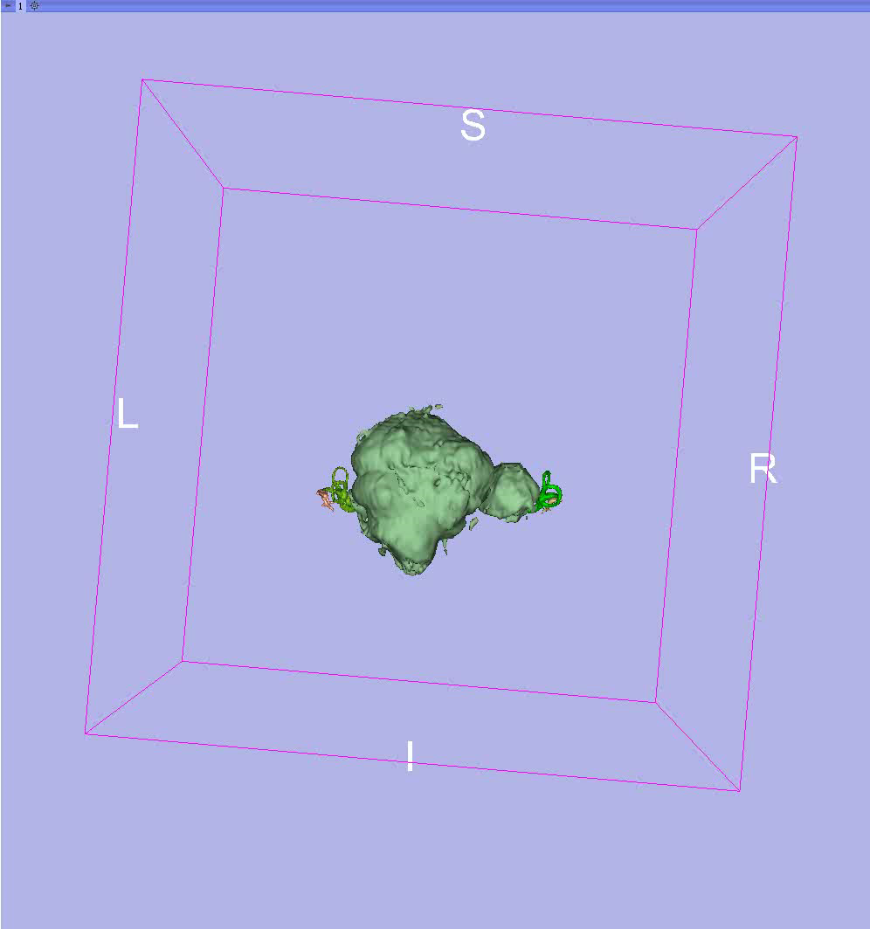
Female patient born in 1985
Anacusis
Brainstem implant candidate
First symptoms at the age of 21 (2006)
First partial surgery in 2006 Sept
left side
Second partial surgery in 2011 Sept
right side
So this is 2012’s MR
…and now we add 2010
This is how the neuromas looked like before the surgery
2008. 02 left side stereotaxic irradiation
2007. 10 right side stereotaxic irradiation
Let’s see 2006 and 2008 together
The neuromas „overlapped” – not at the same time though…
(2006 – 2010)
Her ventricles in 2006
Her ventricles in 2010

